Slide 1
Go term visualizations
Jochum, Michael D.
9 November 2020

Slide 2
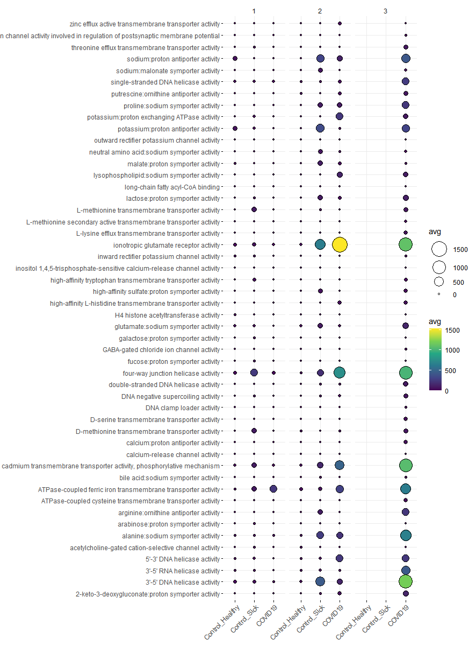
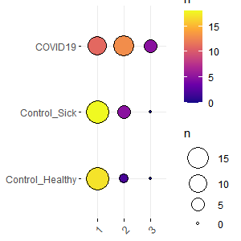
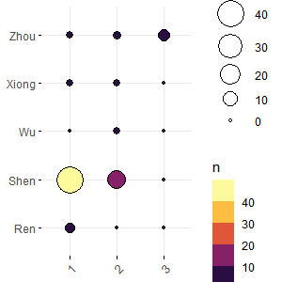
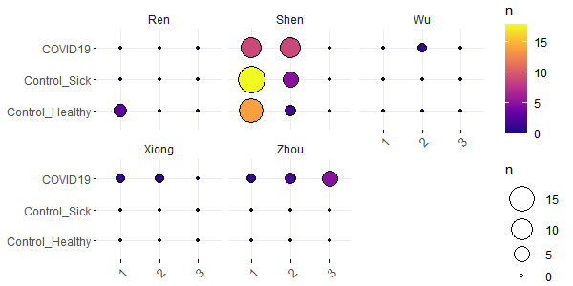
Bubble plots of samples vs dmm cluster vs disease for molecular functions with depth > 10

Slide 3
Bubble plots of samples vs dmm cluster vs disease for molecular functions with depth > 10
Pre- processing GO_Terms
Pre-processing Steps Taken | Go Term (n) | samples
Subset for biological processes only | 4236 | 167
Removed neg control and Unknown sample types | 4236 | 141
Removed Go terms and samples with summation < 10 | 3504 | 136
Agglomerated Go_terms by name | 3477 | 136
Remove all molecular function with depth < level 10 | 50 | 136
Remove all sample with < 0 terms remaining | 50 | 122
Remove all sample with < 0 terms remaining | 50 | 71

Slide 4
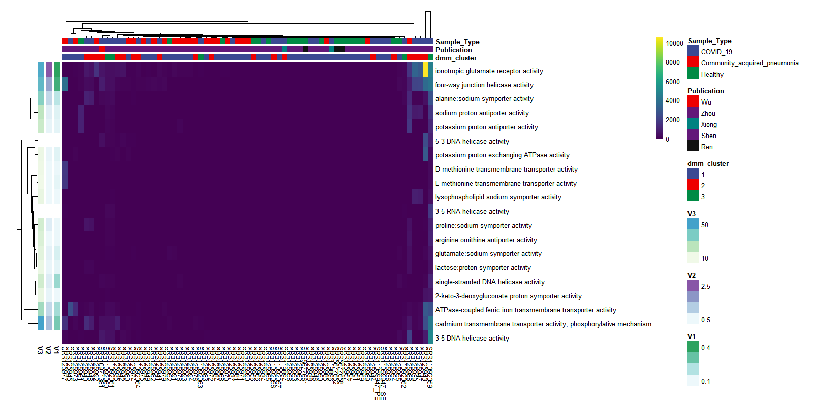
Heatmap of molecular functions with depth > 10

Slide 5
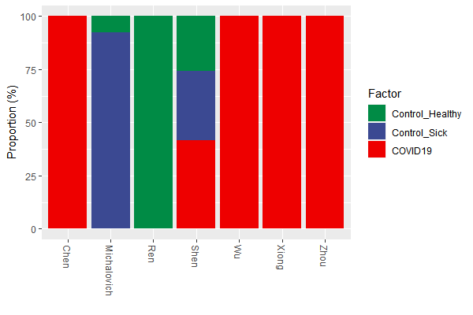
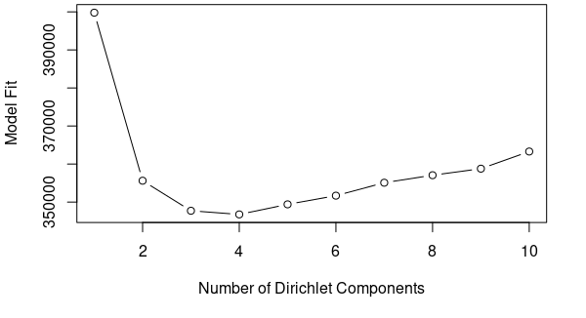
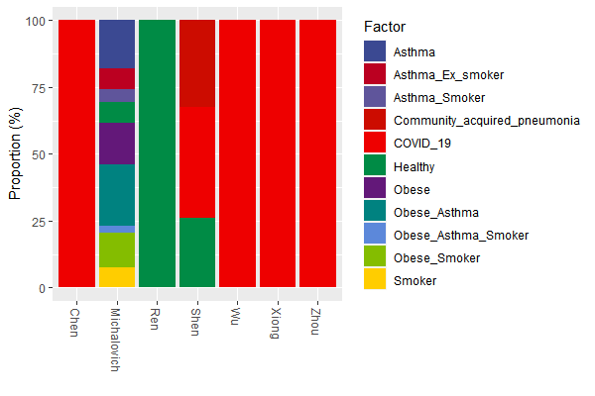
Pre- processing GO_Terms
Pre-processing Steps Taken | Go Term (n) | samples
Subset for biological processes only | 5533 | 167
Removed neg control and Unknown sample types | 3393 | 141
Removed Go terms and samples with summation < 10 | 3470 | 135
Agglomerated Go_terms by name | 3458 | 135
DMM model fit

Slide 6
Go term visualizations
Jochum, Michael D.
2 November 2020

Slide 7
Pre- processing GO_Terms
Pre-processing Steps Taken | Go Term (n) | samples
Subset for biological processes only | 3393 | 167
Removed neg control and Unknown sample types | 3393 | 141
Removed Go terms and samples with summation < 10 | 2212 | 134
Agglomerated Go_terms by name | 2107 | 134
DMM model fit

Slide 8
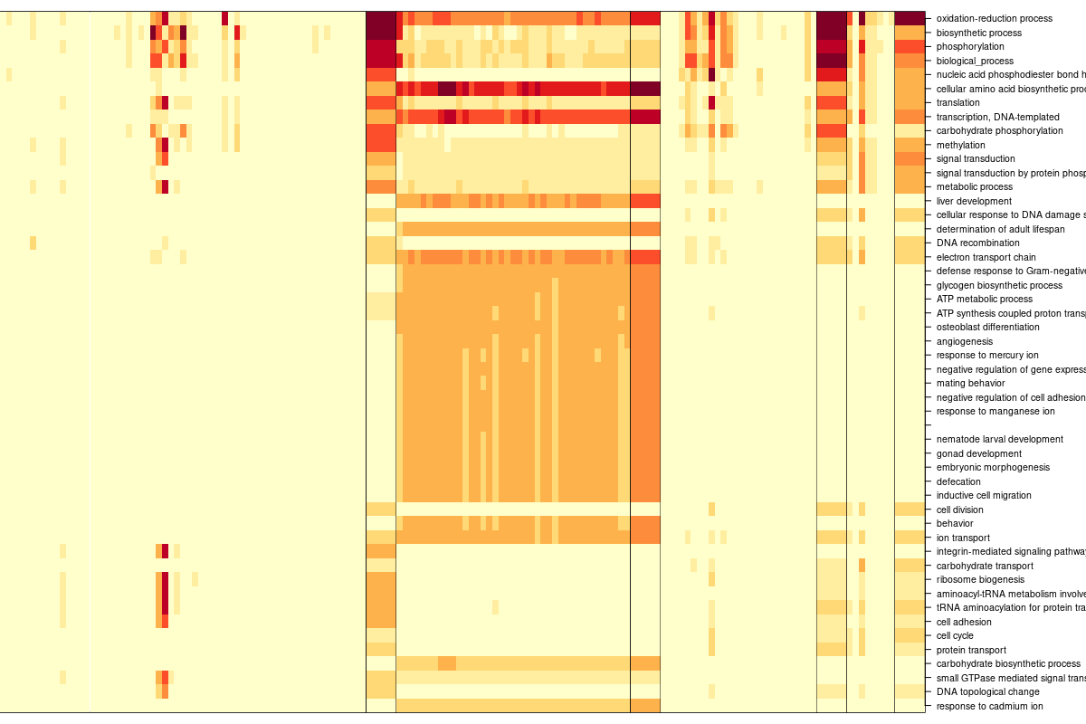
Square root transformed Dirichlet Multinomial Mixtures Community typing (k=4)

Slide 9
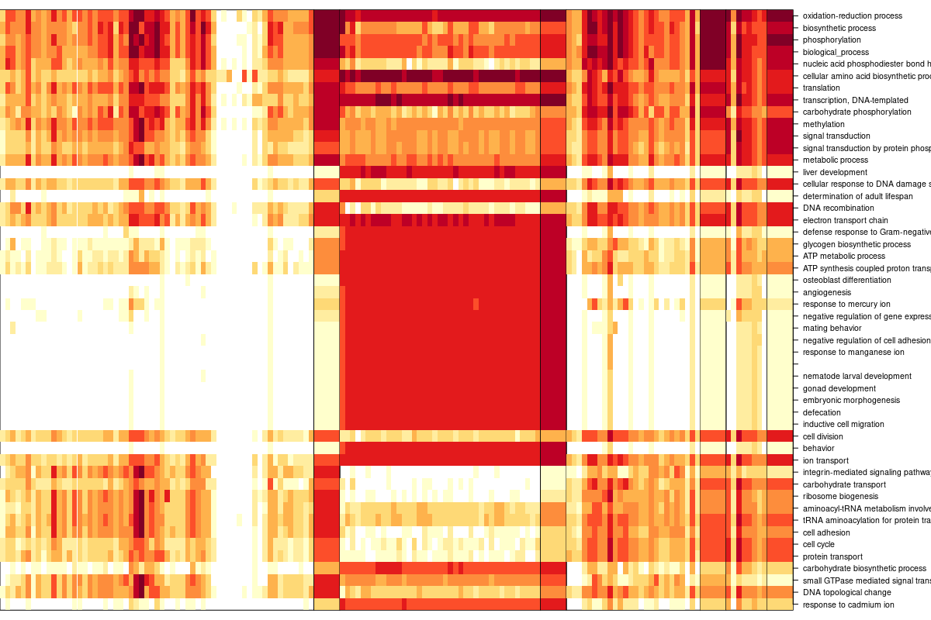
Log 2 Dirichlet Multinomial Mixtures Community typing (k=4)

Slide 10
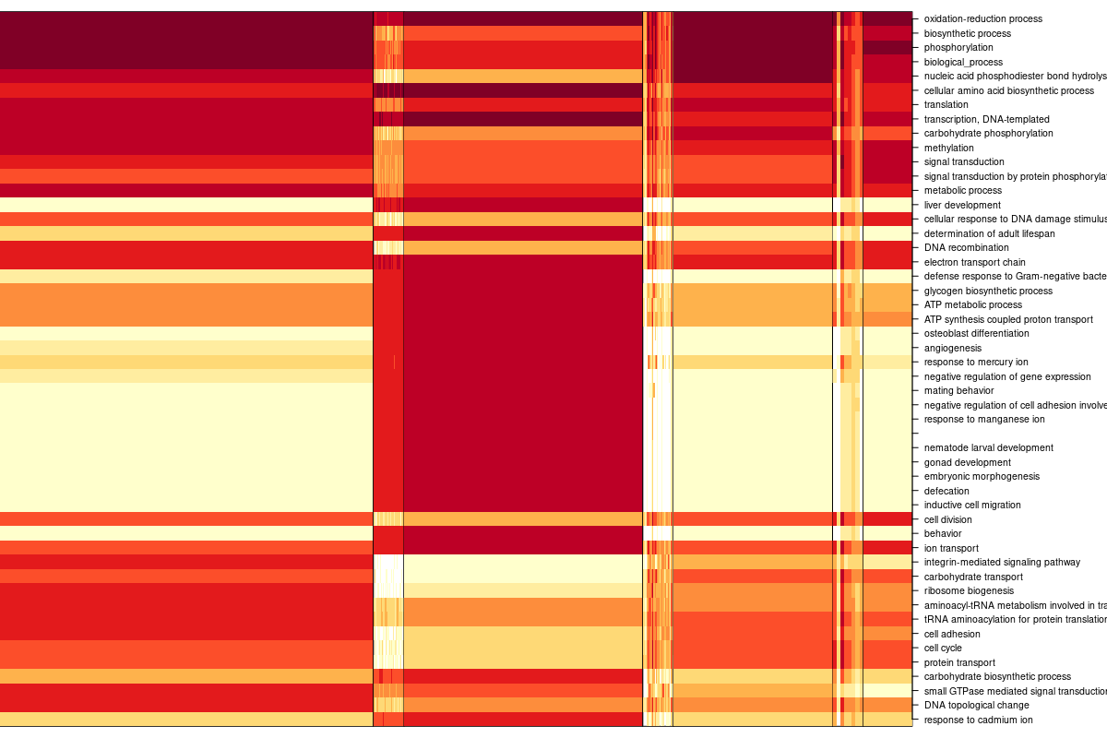
Log 10 Dirichlet Multinomial Mixtures Community typing (k=4)

Slide 11
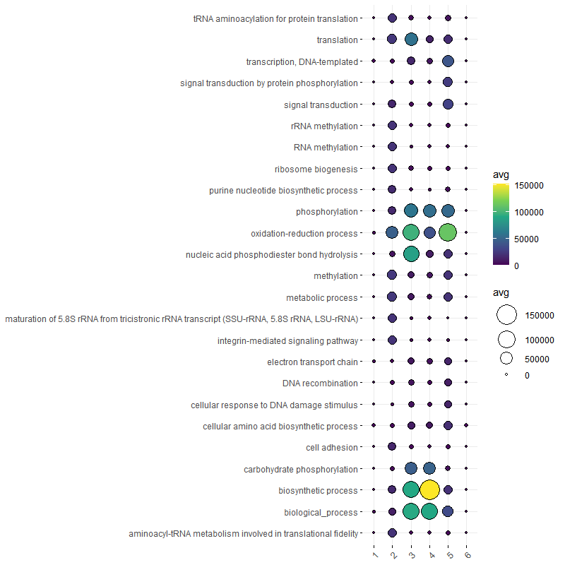
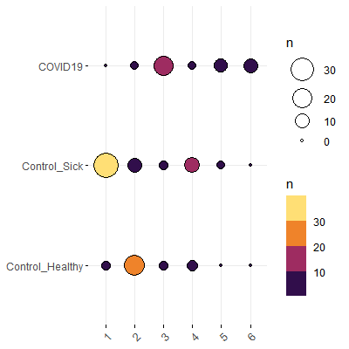
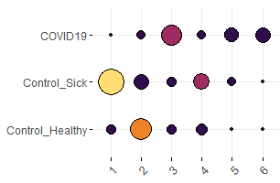
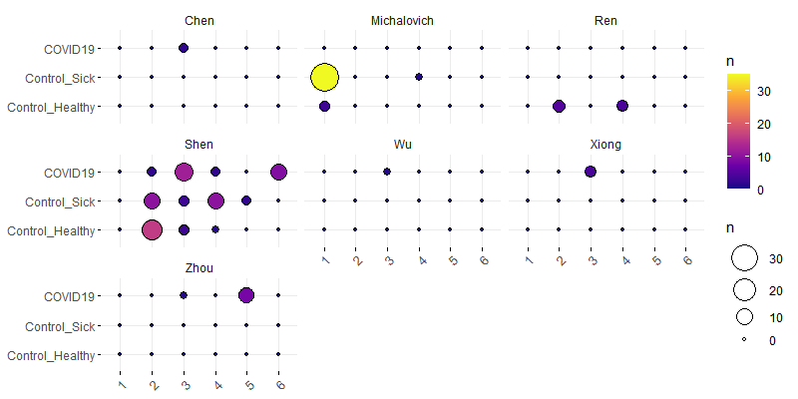
Bacteria derived biological process GO term Dirichlet Multinomial Mixtures Community typing (k=6)
DMM group (x) by case (y), colored by count
DMM group (x) by case (y) faceted by publication, colored by count

Slide 12
OLD STUFF Go term visualisations
Jochum, Michael D.
27 Oct 2020

Slide 13
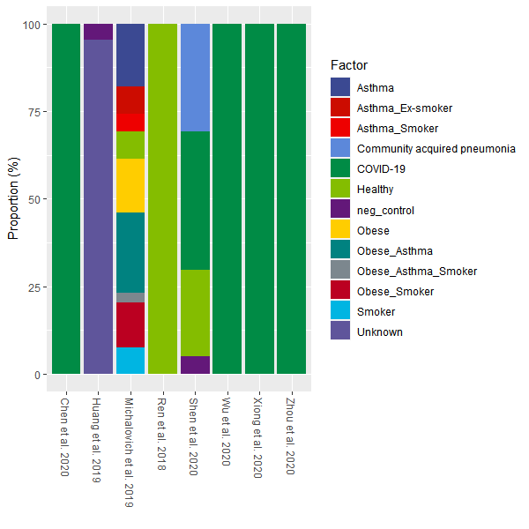
Proportion of samples types by publication

Slide 14
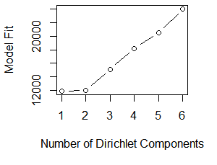
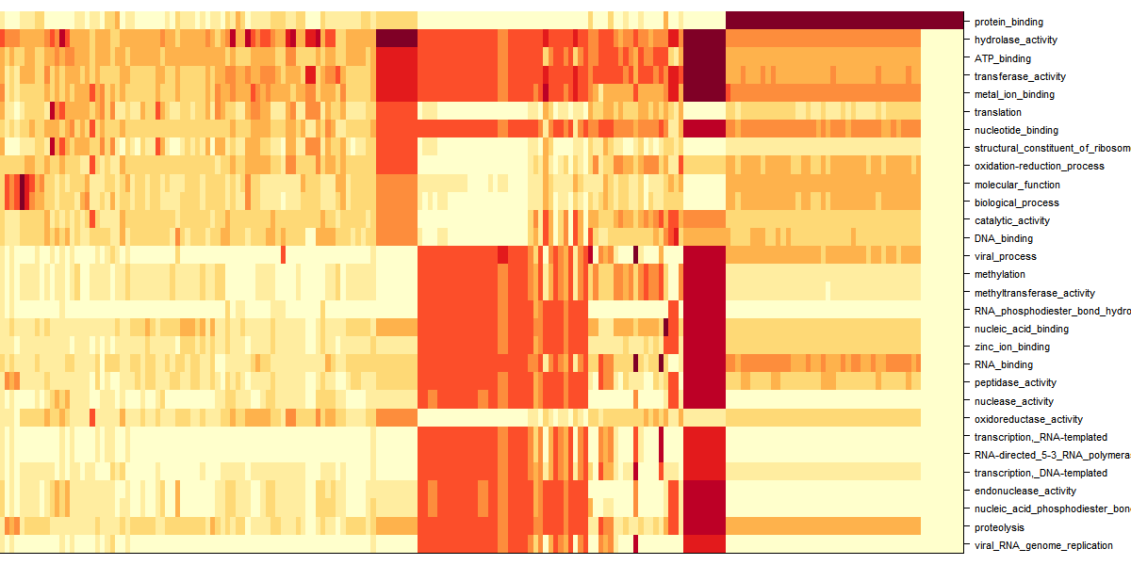
Dirichlet Multinomial Mixtures Community typing

Slide 15
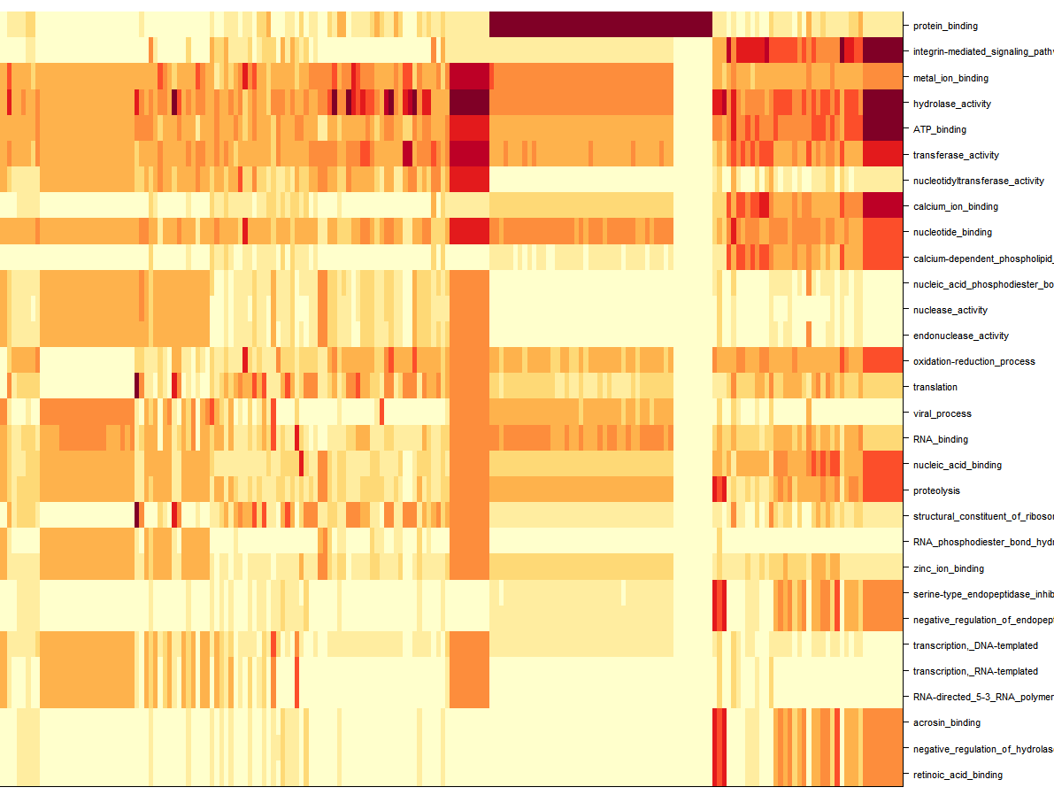
Dirichlet Multinomial Mixtures Community typing

Slide 16
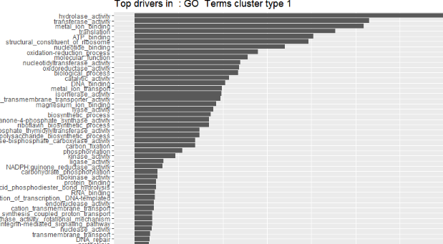
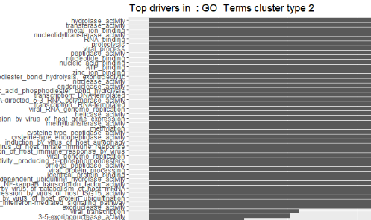
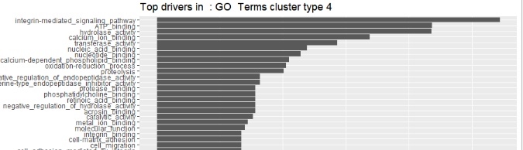
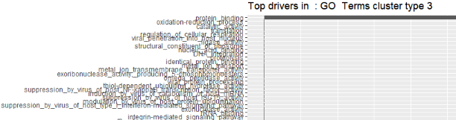
Dirichlet Multinomial Mixtures Community typing

Slide 17
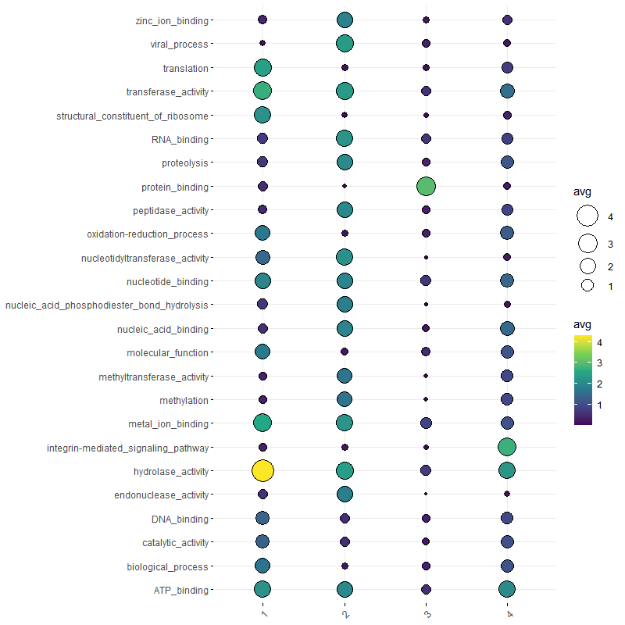
Dirichlet Multinomial Mixtures Community typing

Slide 18
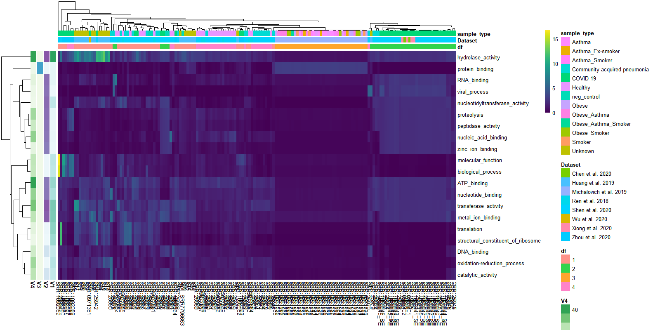
Dirichlet Multinomial Mixtures Community typing

